Slide 1




AI-Generated
Image
Classification

Slide 2


Our Team
Omar Ayman
Mariam Amgad
Ahmed Khaled
Yasmin Zidan
Roaa Alaa
Supervised by: Dr.Marwa Reda

Slide 3

Introduction
With the rise of AI-generated media, it's becoming increasingly important to differentiate between real and artificial content. These distinctions are crucial for media authenticity, cybersecurity, and even the entertainment industry.
This project focuses on detecting AI-generated (fake) vs. real images using deep learning and machine learning approaches.

Slide 4

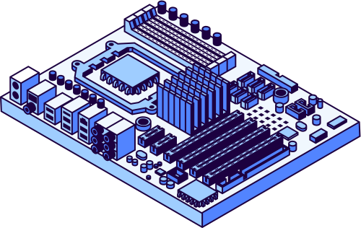
Dataset
Dataset Source
CIFAKE - Real and AI-generated synthetic images (Kaggle)
Structure
Train/Test Splits
Classes:
1- REAL: Images captured from real-world sources.
2-FAKE: AI-generated images.
Sample Size
1000 images per each class

Slide 5

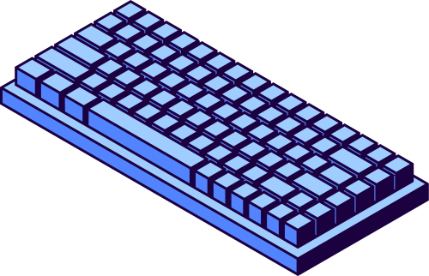
Workflow
Step 1: Data Preprocessing
Step 2: Classification Model
Step 3: Model Training
Step 4: Model Evaluation

Slide 6
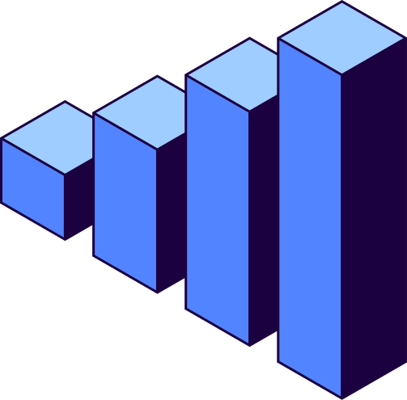
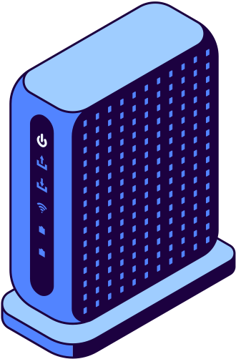
Step 1: Data Preprocessing
Step 1: Dataset preparation
Step 2: Image Preprocessing
Custom Dataset Class:
Created a CustomImageDataset class to load images from the CIFAKE dataset.
Limits the dataset to 3,000 images per class (REAL and FAKE) to prevent memory issues.
Applied a transformation pipeline using torchvision.transforms:
Resize all images to 224x224 (standard input size for ResNet18).
Convert images to tensors.
Normalize images using ImageNet mean and standard deviation:
Mean: [0.485, 0.456, 0.406]
Std: [0.229, 0.224, 0.225]

Slide 7
Step 1: Data Preprocessing
Step 3: Feature Extraction with ResNet18
Step 4: Embedding Generation
Loaded ResNet18 model pretrained on ImageNet.
Removed the classification layer to use the feature extractor part of the model.
Extracted feature vectors for each image from the second-to-last layer.
Passed the preprocessed images through the ResNet18 feature extractor:
Images are loaded in batches of 32 using DataLoader.
Feature embeddings (2048-dimensional vectors) are obtained for each image.
REAL images are labeled 0 and FAKE images are labeled 1

Slide 8
Classification Models
MLP (multi-layer-perceptron)
KAN (kolmogorov- Arnold-network)
The MLP (Multi-Layer Perceptron) is a fully connected neural network designed to classify REAL vs FAKE images based on the extracted feature embeddings.
KANs replace traditional weights in neural networks with learnable activation functions on edges.
Instead of static linear weights, KANs use univariate functions parametrized as splines.
No linear weights are used at all, resulting in a more flexible and powerful network.

Slide 9
MLP Architecture Overview
Input Layer
Dimension: input_dim is The size of the feature vectors (e.g., 2048 from ResNet18).
Hidden Layers
Layer 1:
Linear layer with hidden_dims[0] units.
Activation Function: ReLU (Rectified Linear Unit).
Dropout: 30% to prevent overfitting.
Layer 2:
Linear layer with hidden_dims[1] units.
Activation Function: ReLU.
Dropout: 30% to further regularize the network.

Slide 10
MLP Architecture Overview
Output Layer
Linear layer with output_dim neurons
(2 for binary classification).
Activation Function: Softmax to output class probabilities.
Key Features
ReLU Activation: Ensures non-linearity, enabling the network to learn complex patterns.
Dropout: Reduces overfitting by randomly deactivating neurons during training.
Softmax Output: Converts raw outputs to probabilities for classification.

Slide 11
MLP Overview
Benefits of the Design
Simple and efficient for binary classification tasks.
Regularization helps generalize well on unseen data.
Modular and easy to extend for multi-class problems.

Slide 12
KAN Architecture Overview
Implementation of KAN in Our Project
We implemented KAN using splines instead of fixed weights.
It includes :
Spline Grid: A set of points to define the spline space.
Learnable Weights: Spline weights (spline_weight) and base weights (base_weight).
Activation Functions: Base activations like SiLU combined with spline activations.

Slide 13
KAN Architecture Overview
How KAN Improves Our Project?
KANs replace MLP's traditional dense layers, providing:
Improved accuracy with fewer parameters.
A more flexible, non-linear activation mechanism on the edges.
Better performance on our dataset (REAL vs FAKE classification).

Slide 14
Step 4: Model Training
MLP Classifier Training Process
KAN Classifier Training Process

Slide 15
MLP Classifier Training Process
Training Steps
Data Preparation:
Loaded pre-extracted embeddings from embeddings.npz.
Split data into training (80%) and validation (20%) sets.
Converted data into PyTorch tensors for compatibility.
Class Balancing:
Calculated class weights to handle imbalanced dataset using sklearn.utils.class_weight.
Applied weighted cross-entropy loss to give more importance to minority classes.
Model Configuration:
Input dimension: Determined by the feature size of embeddings.
Hidden layers: Two fully connected layers with 256 units each.
Output dimension: Binary classification (REAL vs FAKE).
Optimizer:
Used Adam optimizer with a learning rate of 0.001.

Slide 16
MLP Classifier Training Process
Training loop
Epochs: 20 iterations
Process:
Forward pass: Compute predictions.
Compute loss: Weighted cross-entropy for robust training.
Backward pass: Update weights using optimizer.

Slide 17


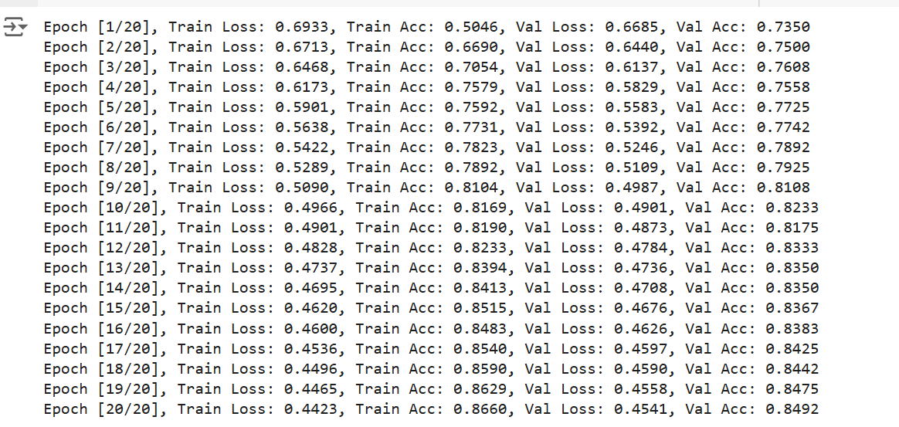
Results
Results Monitored Per Epoch:
Training Loss , Accuracy
Validation loss, Accuracy

Slide 18
KAN Classifier Training Process
Training and Validation Process
1-Training Function:
Purpose: Optimizes model parameters using the training dataset.
Steps:
Forward pass: Compute predictions for training data.
Calculate loss using CrossEntropyLoss.
Backward pass: Update model weights using Adam Optimizer.
Track total loss and accuracy for the epoch.
Metrics Returned:
Training Loss: Average loss over all batches.
Training Accuracy: Ratio of correct predictions.
2-Validation Function:
Purpose: Optimizes model parameters using the training dataset.
Steps:
Forward pass: Compute predictions without gradient calculations.
Calculate loss for the validation set.
Track total loss and accuracy without updating weights.
Metrics Returned:
Validation Loss: Average loss on unseen data.
Validation Accuracy: Accuracy on validation dataset.

Slide 19
KAN Classifier Training Process
Main Training loop
Epochs: 10 iterations
Process:
Device: GPU or CPU depending on availability.
Model: KANResNet18 initialized for binary classification (2 classes).
Loss Function: CrossEntropyLoss for classification tasks.
Optimizer: Adam with a learning rate of 0.001.
Epochs: 10 iterations of training and validation.
Process per Epoch:
Train the model on training data.
Evaluate model performance on validation data.
Print:
Train Loss and Train Accuracy
Validation Loss and Validation Accuracy

Slide 20
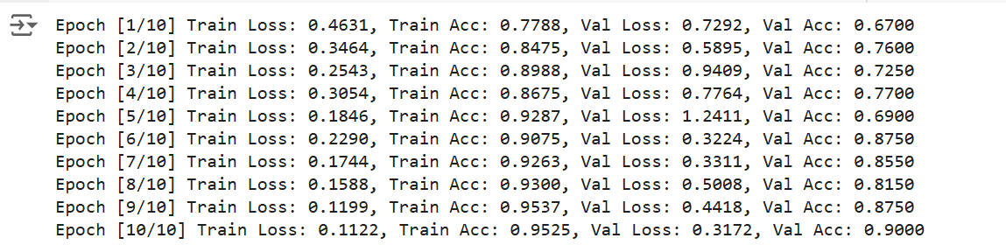
Results
Results Monitored Per Epoch:
Training Loss , Accuracy
Validation loss, Accuracy

Slide 21


Model Evaluation
Evaluation Metrics
After training, the model's performance is evaluated using the(MLP or KAN) Classifier on the training and validation datasets.
Metrics calculated include:
Accuracy: The percentage of correctly predicted samples.
Precision: The ratio of true positives to predicted positives (how accurate are the positive predictions).
Recall: The ratio of true positives to actual positives (sensitivity of the model).
F1-Score: The harmonic mean of precision and recall.

Slide 22
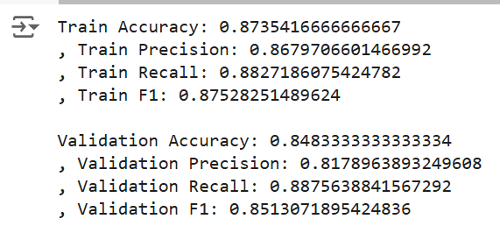
Results of Evaluation for MLP
Train Accuracy, precision, Recall, F1
Validation Accuracy, Precision, Recall, F1

Slide 23
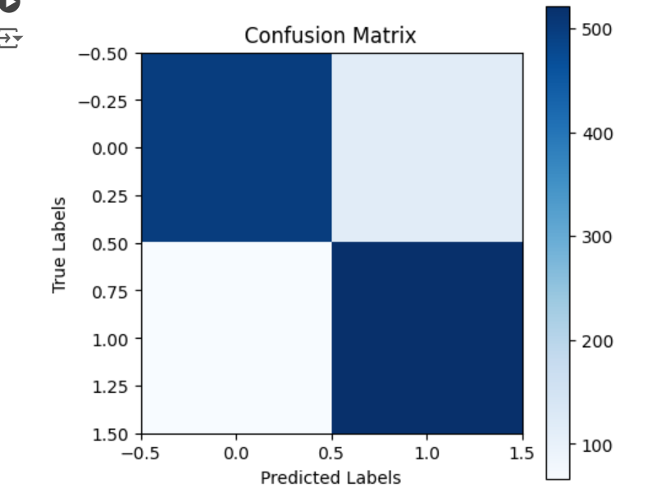
Results of Evaluation for MLP
Confusion Matrix

Slide 24
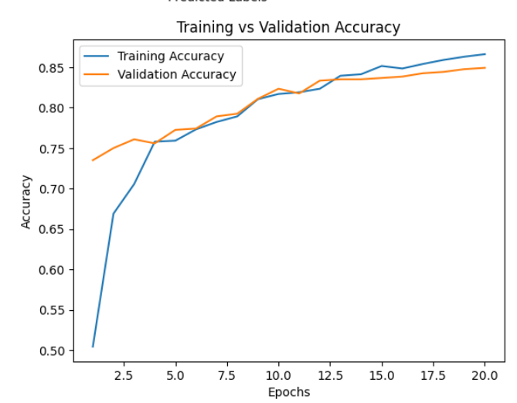
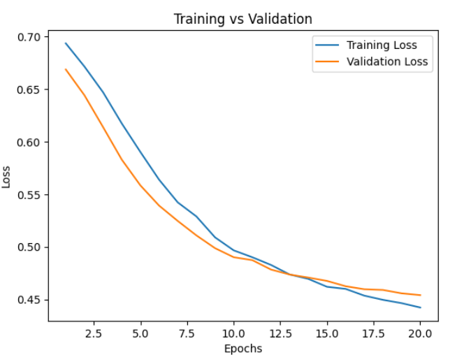
Results of Evaluation for MLP
Accuracy Plot
Loss Plot

Slide 25
Results of Evaluation for KAN
Test Accuracy, precision, Recall, F1

Slide 26
Comparison MLP vs KAN
MLP
KAN
Requires more training epochs to achieve comparable performance.
More prone to overfitting and oscillations during loss reduction.
Struggles with complex, highly nonlinear data.
MLP is computationally cheaper but sacrifices accuracy and generalization.
Achieves higher accuracy and F1-scores across training and validation datasets.
Demonstrates faster convergence due to its expressive and adaptive nature.
Produces smoother, interpretable mappings through learnable splines.
KAN has a slightly higher computational cost due to spline evaluations.

Slide 27


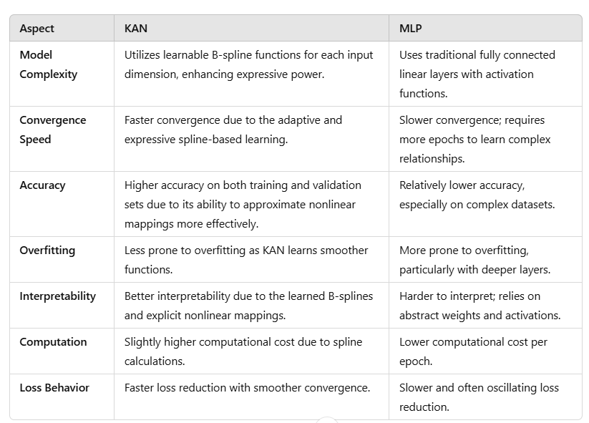
Key Observations

Slide 28
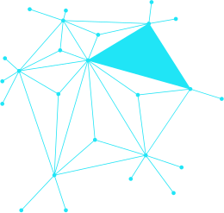


Thank You!
Sources
https://github.com/mintisan/awesome-kan
https://github.com/juntaoJianggavin/kan-cifar10
https://www.arxiv.org/abs/2408.09371
https://www.kaggle.com/datasets/birdy654/cifake-real-and-ai-generated-synthetic-images

